Slide 2
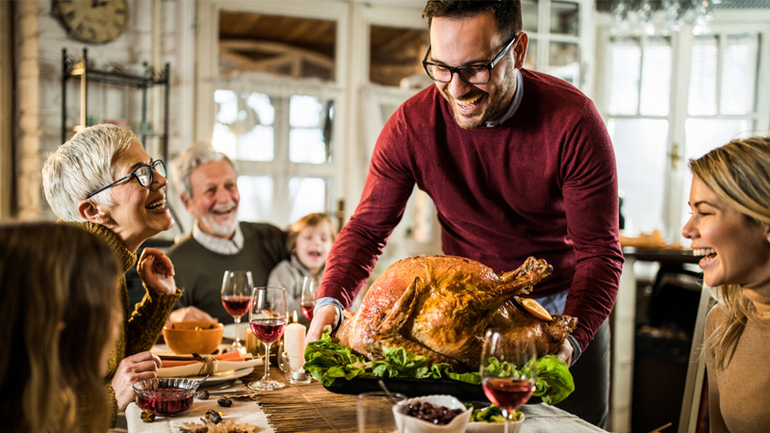
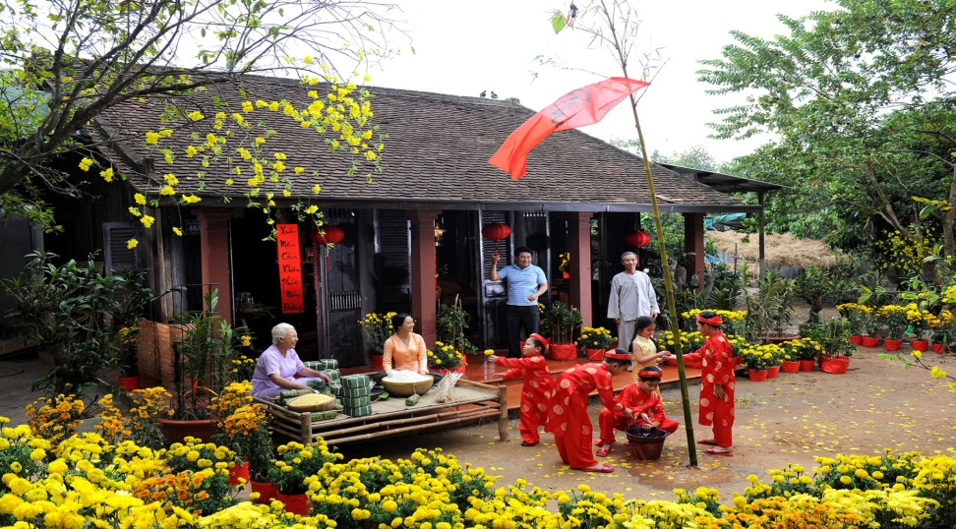
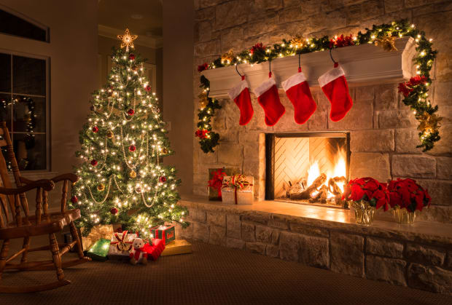
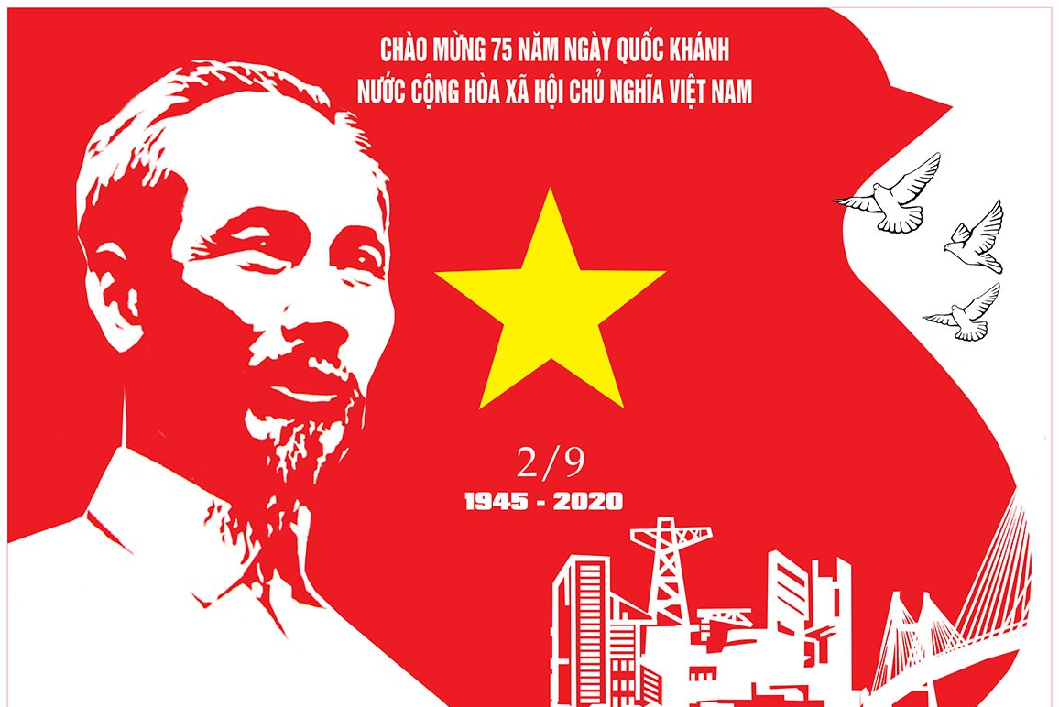
What is the name of the public holiday in each of these pictures ?
Thanksgiving
Tet Holiday
Christmas
Independence day

Slide 3
UNIT 7: THE WORLD OF WORK Part B: The worker
Lesson 4: B1,3, 4

Slide 5
UNIT 7: THE WORLD OF WORK B: The worker
Vocabulary
mechanic
machine

Slide 6
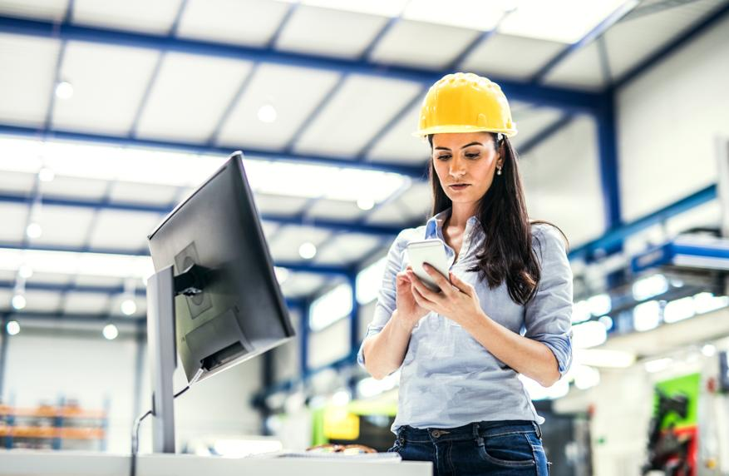
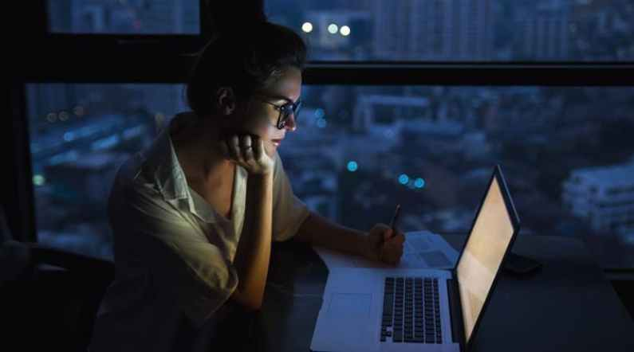
UNIT 7: THE WORLD OF WORK B: The worker
Vocabulary
morning shift
night shift

Slide 7
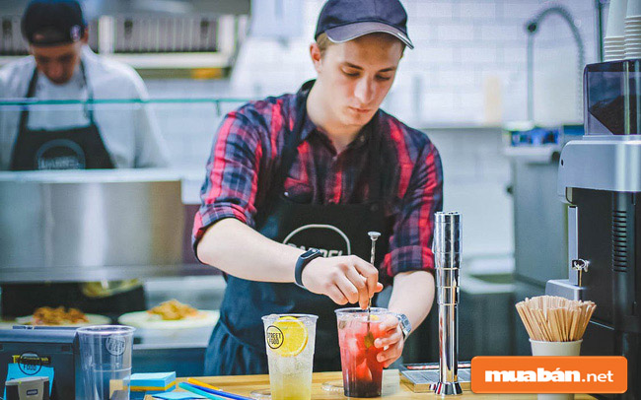
UNIT 7: THE WORLD OF WORK B: The worker
Vocabulary
He works part-time at a restaurant

Slide 8
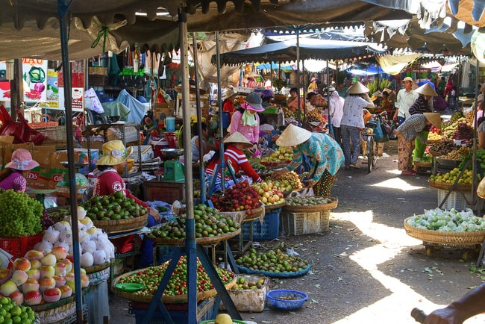
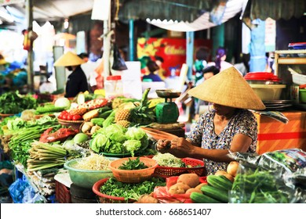
UNIT 7: THE WORLD OF WORK B: The worker
Vocabulary
local market

Slide 9
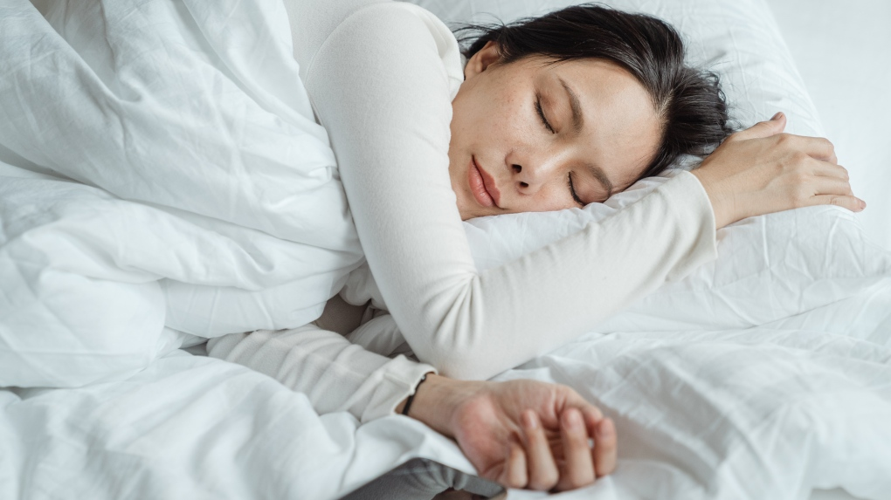
UNIT 7: THE WORLD OF WORK B: The worker
Vocabulary
I usually get up late on my day off

Slide 10
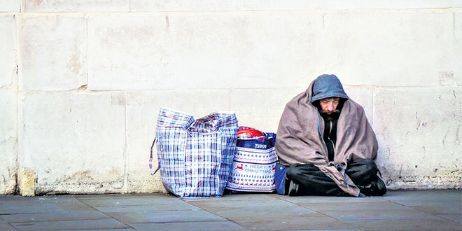
UNIT 7: THE WORLD OF WORK B: The worker
Vocabulary
homeless

Slide 11
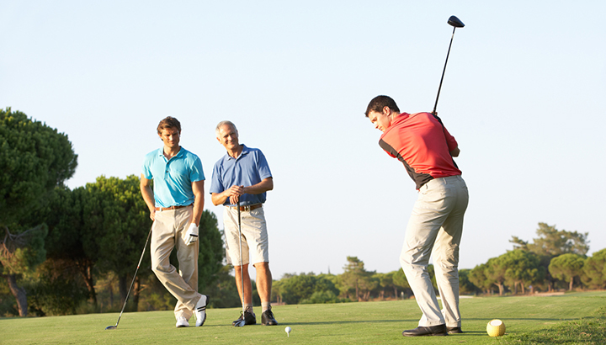
UNIT 7: THE WORLD OF WORK B: The worker
Vocabulary
They sometimes play golf in the morning

Slide 12
UNIT 7: THE WORLD OF WORK B: The worker
Vocabulary
machine (n): piece of equipment
mechanic (n): someone who repair or work with machine
shift (n): the period of working time
part-time (adj/adv) → work part-time
local (adj): particular or small area
day off (n): a day when you do not work
homeless (adj): without a home
golf (n) → play golf

Slide 13
UNIT 7: THE WORLD OF WORK B: The worker
Fill in each blank with a suitable word from the box
homeless shifft mechanic
day off part-time machine
1. She works a ____________ job three days a week.
2. I put my sweater into the washing ___________.
3. I usually help my mom with housework on my _________.
4. The ____________ is preparing my car in the garage now.
part-time
machine
day off
mechanic

Slide 14
UNIT 7: THE WORLD OF WORK B: The worker
B1. Listen and read
Dear Hoa, I am pleased that you and your family are well. I am fine, too. Here is a photo of me, my mom and dad, and my sister, Shanon. Can you send me a photo of you? Let me tell you more about my parents. My mom works at home. She takes care of the family. Three mornings a week, she works part time at a local supermarket. She and other women also cook lunch for homeless people once a week.
My dad is a mechanic. He repairs machines in a factory. He works five days a week for about 40 hours, sometimes in the morning and sometimes in the afternoon. He prefers the morning shift. He has fewer days off than my Mom. However , when he has an afternoon free, he plays golf. Dad gets about seven public holidays each year .He also has a three-week summer vacation. We always go to Florida on vacation. We have a great time and dad plays more golf. Please write soon and tell me more about your family. Best wishes, Tim
A letter from Tim Jones

Slide 15
UNIT 7: THE WORLD OF WORK B: The worker
Decide the following sentences are True (T) or False (False)
 | True | False
1. Tim’s father works in a garage.
2. Tim’s mother is a housewife.
3. His father likes playing golf.
4. He prefers afternoon shift.
5. His mother cooks lunch for homeless people twice a week.
factory.
morning
once

Slide 16
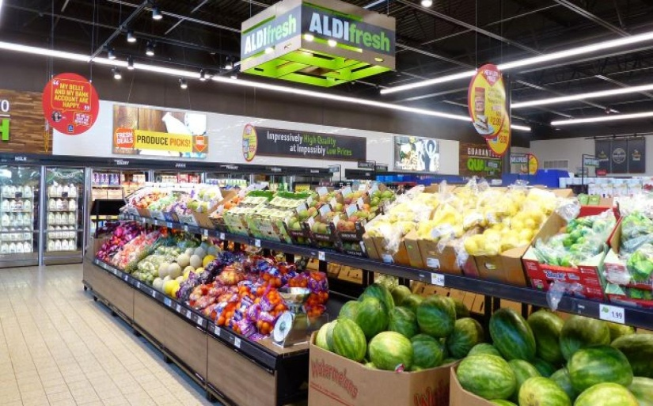
UNIT 7: THE WORLD OF WORK B: The worker
Choose a picture and answer the questions
A
B
1.Where does Mrs. Jones work ?
→ She works at a local supermarket

Slide 17
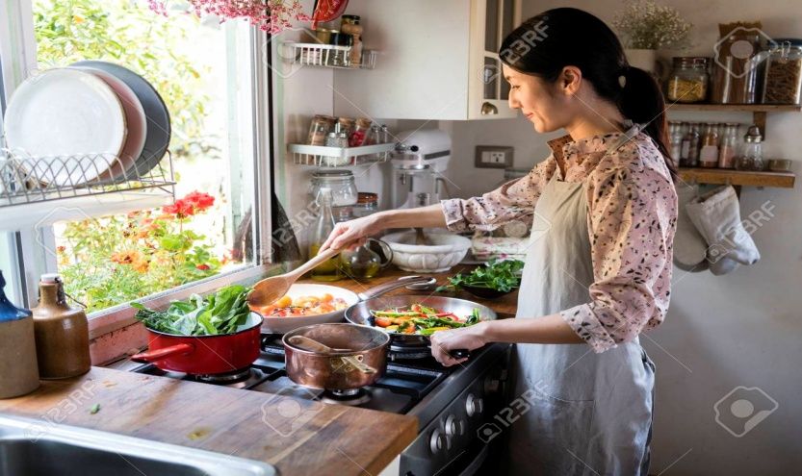
UNIT 7: THE WORLD OF WORK B: The worker
Choose a picture and answer the questions
A
B
2. What does she do for homeless people?
→ She cooks lunch for homeless people

Slide 18
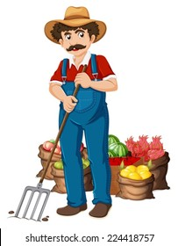
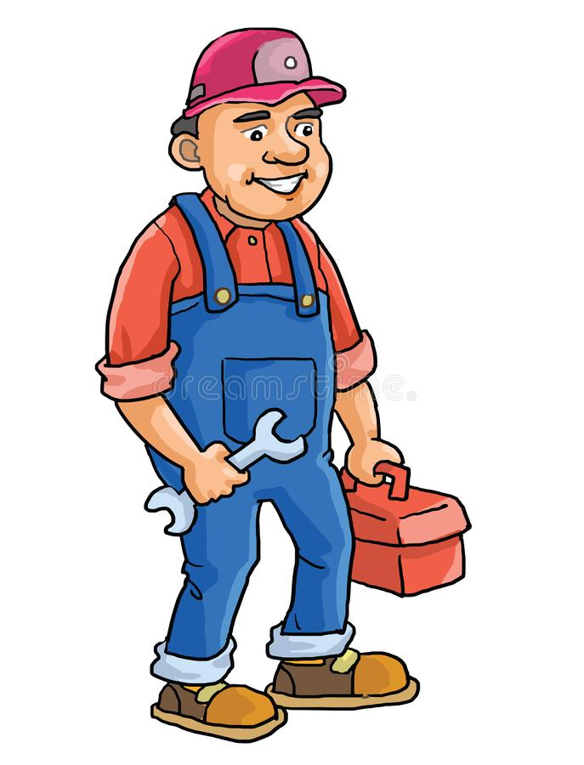
UNIT 7: THE WORLD OF WORK B: The worker
Choose a picture and answer the questions
A
B
3. What is Mr. Jones’ job?
→ He is a mechanic

Slide 19
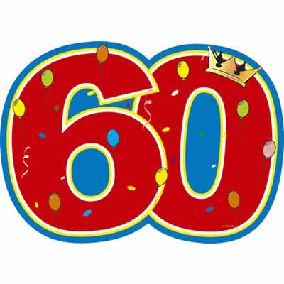
UNIT 7: THE WORLD OF WORK B: The worker
Choose a picture and answer the questions
A
B
4. How many hours a week does he usually work ?
→ He usually works 40 hours a week

Slide 20
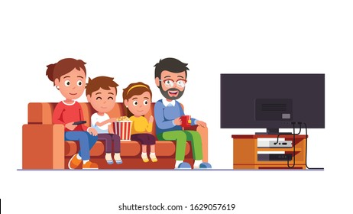
UNIT 7: THE WORLD OF WORK B: The worker
Choose a picture and answer the questions
A
B
5. How do you know the Jones family likes Florida ?
→ They always go to Florida on vacation because they have a great time

Slide 21
Remember
Comparison of countable noun :
Tim’s father has fewer days off than his mother.
Tim’s mother has more days off than his father
Compound adjectives :
A break lasts twenty minutes -> A twenty – minute break
A summer vacation lasts three months -> A three - month summer vacation

Slide 22
Unit 7: The World of Work B. The worker – B3
* Compare:
Name | Hours per week | Days off | Vacation time
Mr. Jones
Mr. Tuan
A 3 week summer vacation
40
2
4 or 5
times a year
No real vacation
84

Slide 23
UNIT 7: THE WORLD OF WORK B: The worker
B4. Listen and take notes
Name | Job | Hours per week | Amount of vacation
Peter
Susan
Jane
Phong
doctor
70
4 weeks
nurse
50
3 weeks
shop assistant
35
1 week
factory worker
48
2 weeks

